Slide 1

Tables in a webpages

Slide 2
Introduction to Tables
What is a Table?
A table is a grid organized into columns and rows, much like a spreadsheet.
1 | 2 | 3 | 4 | 5
6 | 7 | 8 | 9 | 10
11 | 12 | 13 | 14 | 15
16 | 17 | 18 | 19 | 20

Slide 3
Why do we use tables?
Tables were initially developed as a method to organize and display data in columns and rows
Creating a Data Table
Activity 1: Creating a Table
 | Monday | Tuesday | Wednesday | Thursday | Friday
6- 7 pm | Look at website | Free | Implementation | Free | Free
7 – 8 pm | Take some notes | Free | Implementation | Free | Free

Slide 4
Cont…
<style> table, th, td { border: 1px solid black; } </style> ….. <TABLE style= “width: 80%” >

Slide 5
Cont…
The <TR> tag
Orange cell | Blue cell | Green cell

Slide 6
<TABLE style= "width: 80%" align = "center"> <tr align = "center">
Orange cell | Blue cell | Green cell

Slide 7
Cont…
<TD width=25% height=70 bgcolor="red"> <p style="font-family: verdana">red cell </p> </td> <TD width=75% bgcolor="lightblue"> <p style="font-family: Comic Sans MS"> light blue cell </p></td>
Orange cell | Blue cell | Green cell

Slide 8
Example Program
<style> table, th, td { border: 1px solid black; } </style> </HEAD> <BODY> <TABLE style= "width: 80%" align = "center"> <caption> CSC503 timetable </caption> <tr > <td width=50%> </td> <th width = 150> Monday </th> <th width = 150> Tuesday</th> <th width = 150> Wednesday </th> <th width = 150> Thursday</th> <th width = 150> Friday</th> </tr> <tr > <td > 6-7pm </td> <td > Look at website</td> <td > free </td> <td > Implementation </td> <td > free </td> <td > free </td> </tr> <tr > <td > 7-8pm </td> <td > Take some notes</td> <td > free </td> <td > Implementation </td> <td > free </td> <td > free </td> </tr> </TABLE> </BODY > </HTML >

Slide 9
Using Tables in Page Design
Tables are useful for laying out text and images on in Web page Advantages: • Default Setting: therefore no new tags are needed — the Web page fills entire space. • Philosophical: flexibility is the philosophy of the Web i.e. it should be accessible by the greatest number of users. • Realistic: resolutions, monitor and window sizes are always different. Keeping a Web page flexible allows it to be viewed on many available formats. Disadvantages: • Uncomfortable: reading text on large monitors is uncomfortable as the lines are too long. • Unpredictability: the designer often cannot predict how a Web page will appear under varying resolutions and live space sizes. • Coherence: on small monitors, everything may not appear correctly.

Slide 10
Using rowspan
<TABLE style= "width: 30%" align = "center">
<tr >
<td bgcolor = "red" rowspan = 2 width = 75> red cell</td>
<td bgcolor = “Blue" height =100> Blue cell</td>
</tr>
<tr >
<td bgcolor = “Orange" height =100> Orange cell</td>
</tr>
</TABLE>
Dark red cell | Blue cell
 | Orange cell

Slide 11
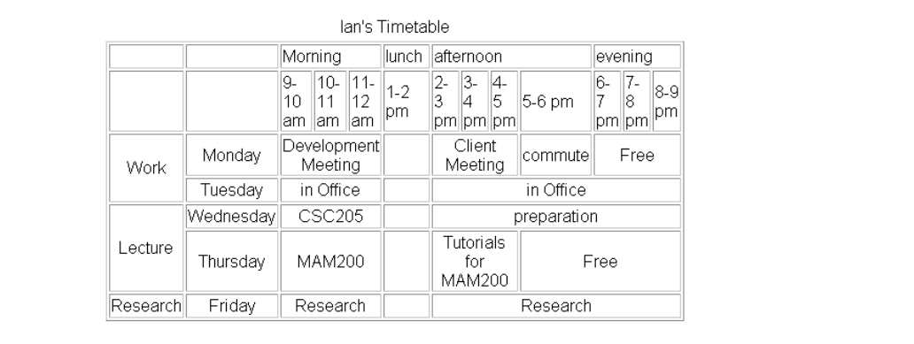
What will be the program code?

Slide 12
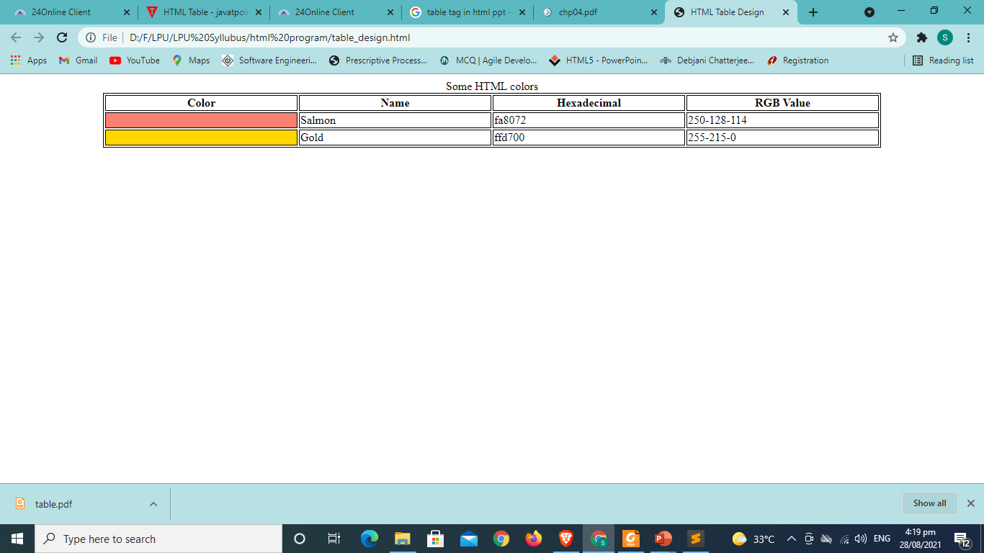
What will be the program code?

